Slide 1
Chapter 4: Threads & Concurrency

Slide 2
Definition
A thread is a basic unit of CPU utilization.
It comprises a thread ID, a program counter (PC), a register set, and a stack.
It shares with other threads belonging to the same process its code section, data section, and other operating-system resources, such as open files and signals.
A traditional process has a single thread of control.
If a process has multiple threads of control, it can perform more than one task at a time.

Slide 3
Motivation
Most modern applications are multithreaded
Threads run within application
Multiple tasks with the application can be implemented by separate threads
Update display
Fetch data
Spell checking
Answer a network request
Process creation is heavy-weight while thread creation is light-weight
Can simplify code, increase efficiency
Kernels are generally multithreaded

Slide 4
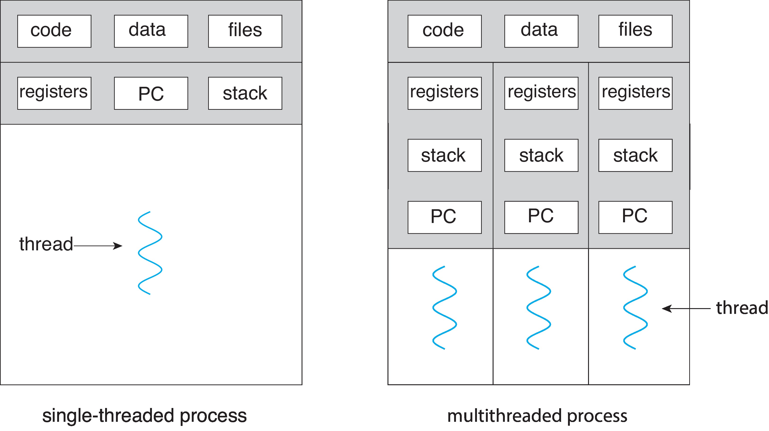
Single and Multithreaded Processes

Slide 5
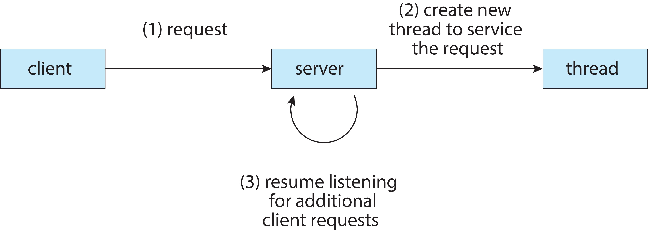
Multithreaded Server Architecture

Slide 6
Benefits
Responsiveness – may allow continued execution if part of process is blocked, especially important for user interfaces
Resource Sharing – threads share resources of process, easier than shared memory or message passing
Economy – cheaper than process creation, thread switching lower overhead than context switching
Scalability – process can take advantage of multicore architectures

Slide 7
Multicore Programming
Multicore or multiprocessor systems puts pressure on programmers, challenges include:
Dividing activities
Balance
Data splitting
Data dependency
Testing and debugging
Parallelism implies a system can perform more than one task simultaneously
Concurrency supports more than one task making progress
Single processor / core, scheduler providing concurrency

Slide 8
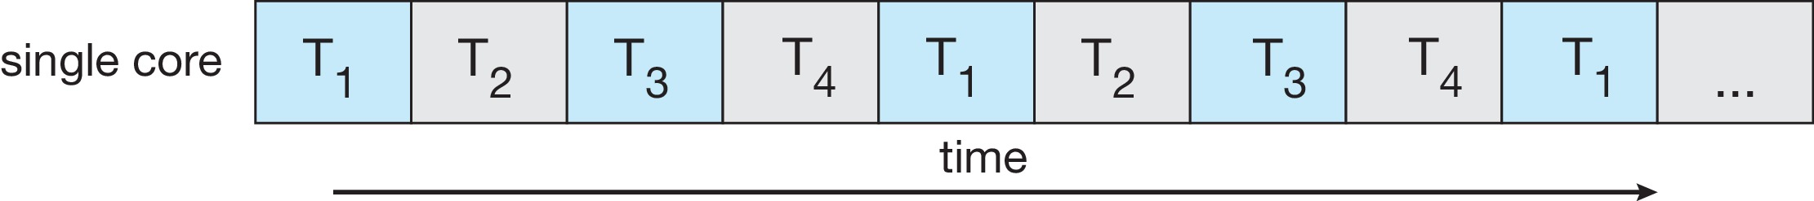
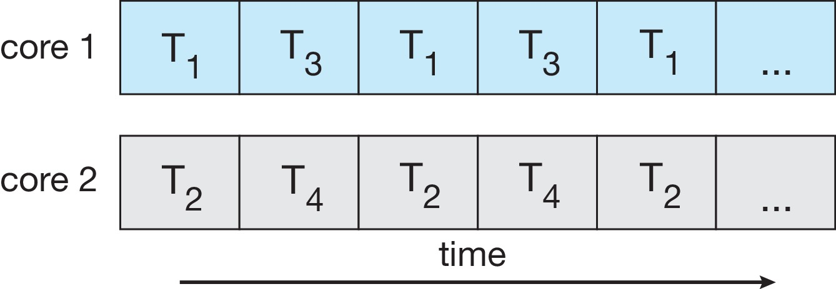
Concurrency vs. Parallelism
Concurrent execution on single-core system:
Parallelism on a multi-core system:

Slide 9
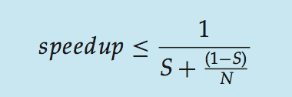
Amdahl’s Law
Identifies performance gains from adding additional cores to an application that has both serial and parallel components
S is serial portion
N processing cores
That is, if application is 75% parallel / 25% serial, moving from 1 to 2 cores results in speedup of 1.6 times
As N approaches infinity, speedup approaches 1 / S
Serial portion of an application has disproportionate effect on performance gained by adding additional cores
But does the law take into account contemporary multicore systems?

Slide 10
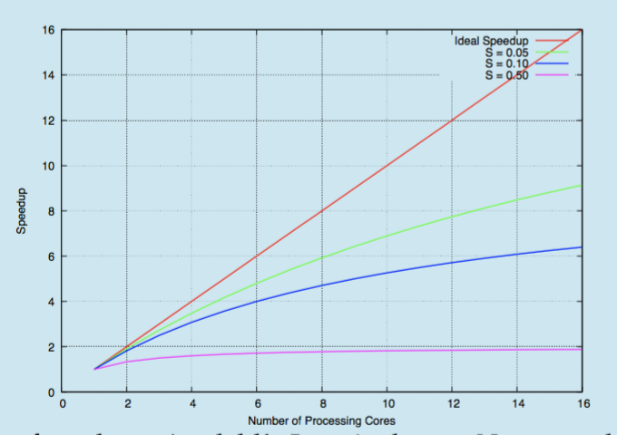
Amdahl’s Law

Slide 11
User Threads and Kernel Threads
User threads - management done by user-level threads library
Three primary thread libraries:
POSIX Pthreads
Windows threads
Java threads
Kernel threads - Supported by the Kernel
Examples – virtually all general-purpose operating systems, including:
Windows
Linux
Mac OS X
iOS
Android

Slide 12
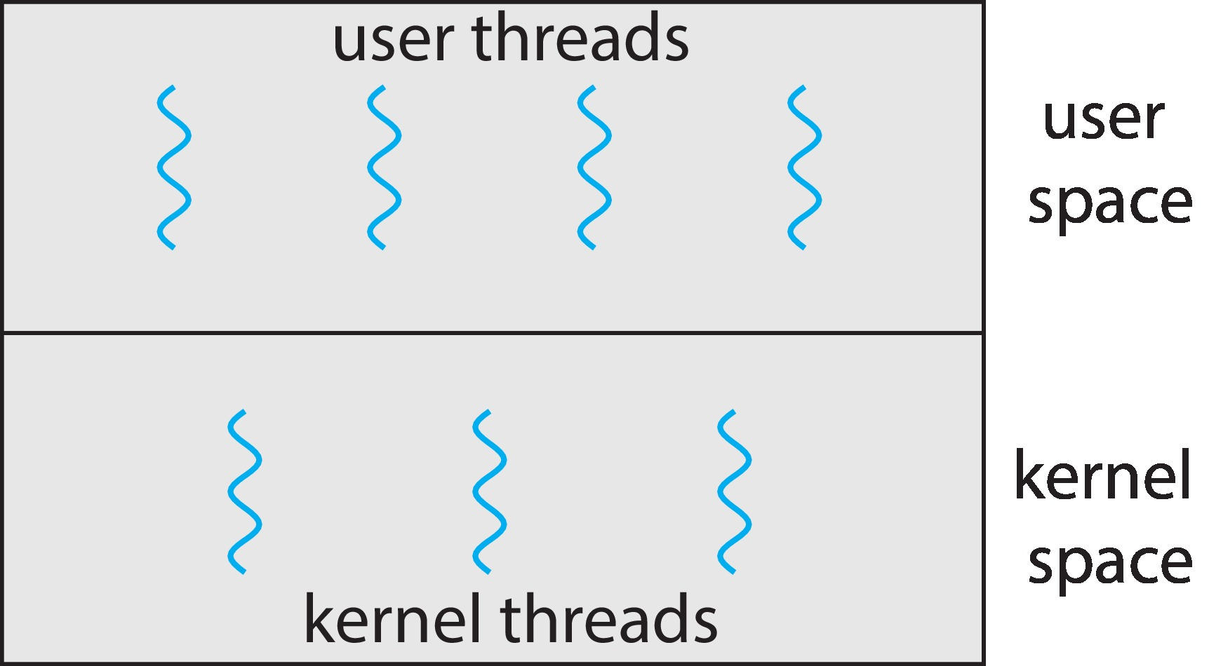
User and Kernel Threads

Slide 13
Multithreading Models
Many-to-One
One-to-One
Many-to-Many

Slide 14
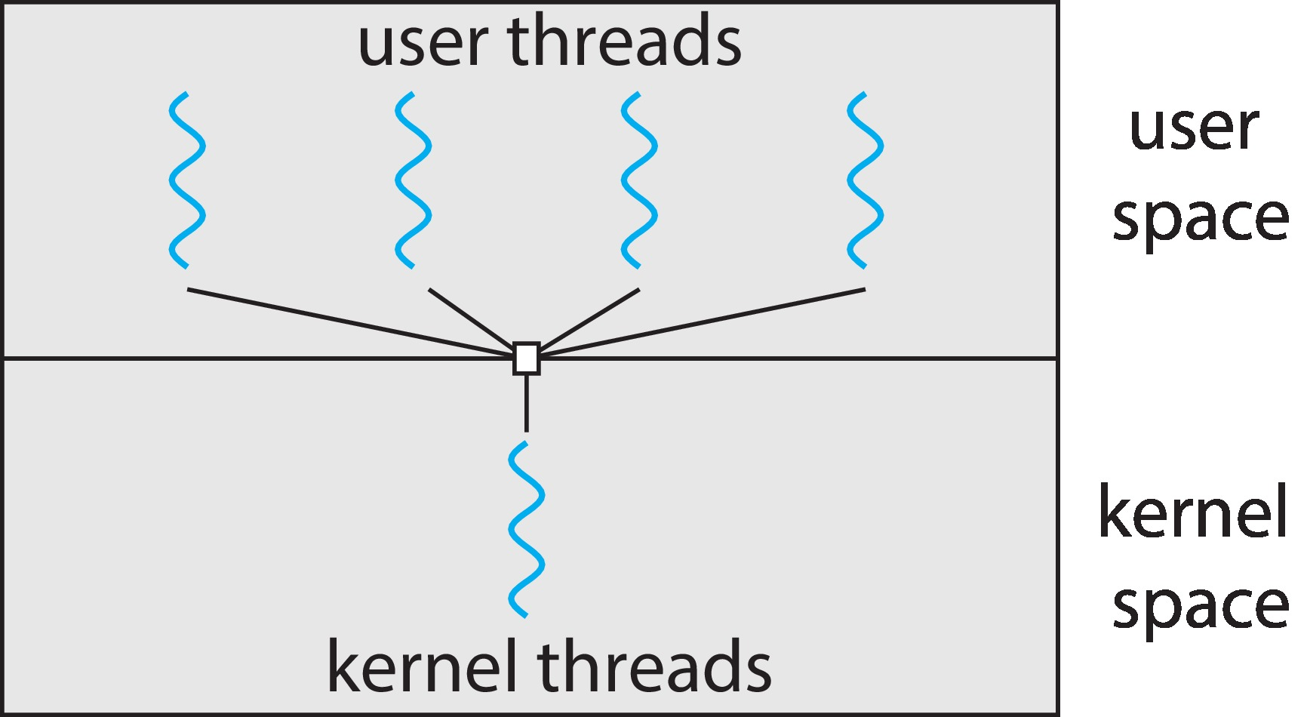
Many-to-One
Many user-level threads mapped to single kernel thread
One thread blocking causes all to block
Multiple threads may not run in parallel on multicore system because only one may be in kernel at a time
Few systems currently use this model
Examples:
Solaris Green Threads
GNU Portable Threads

Slide 15
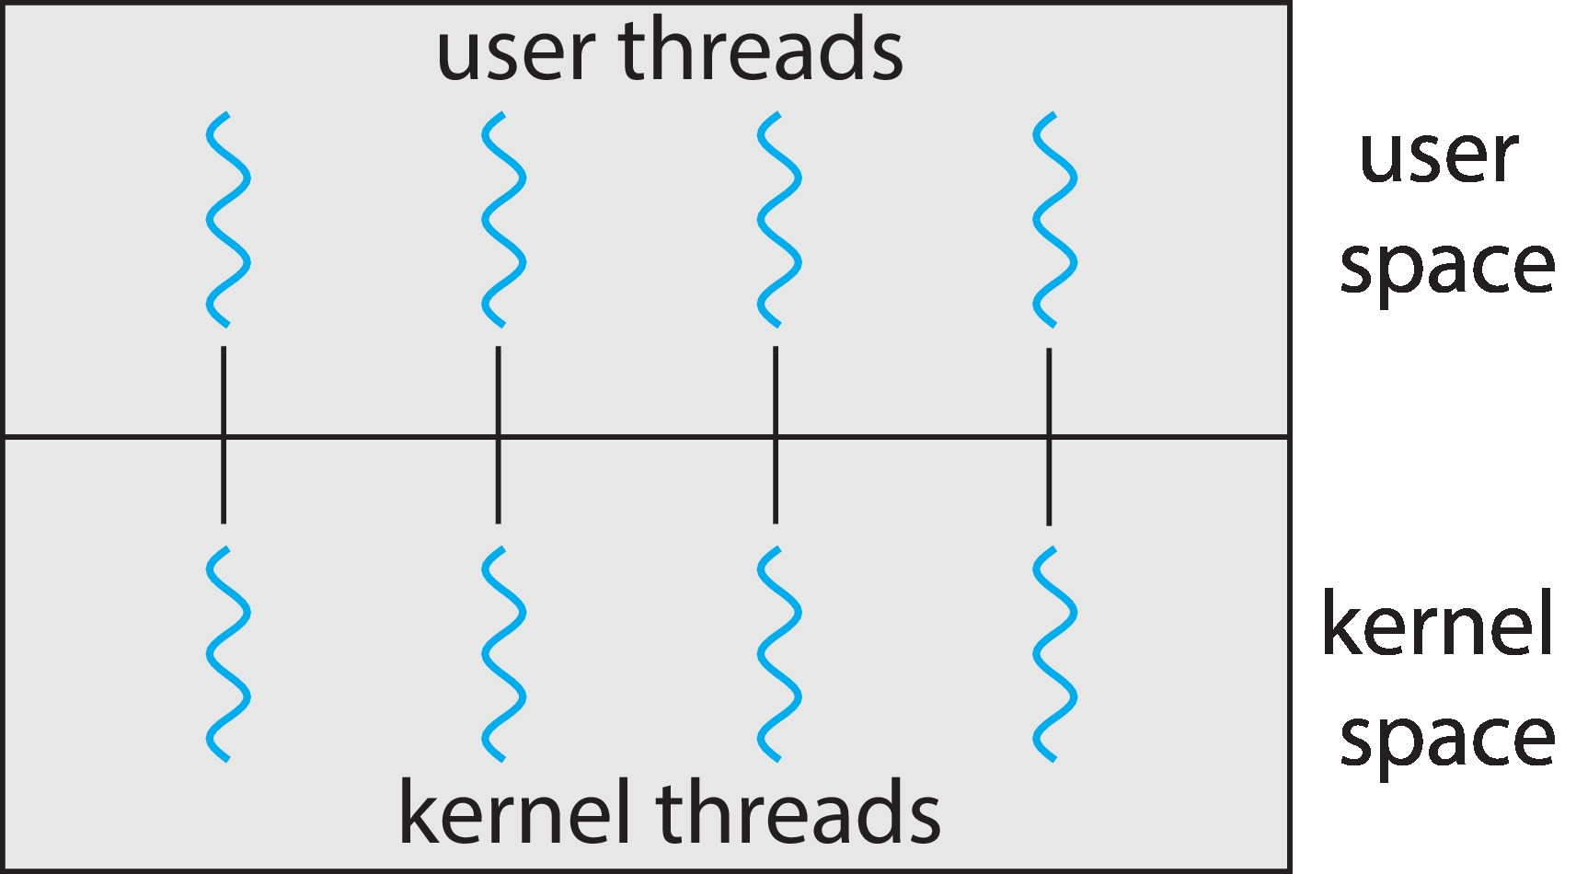
One-to-One
Each user-level thread maps to kernel thread
Creating a user-level thread creates a kernel thread
More concurrency than many-to-one
Number of threads per process sometimes restricted due to overhead
Examples
Windows
Linux

Slide 16
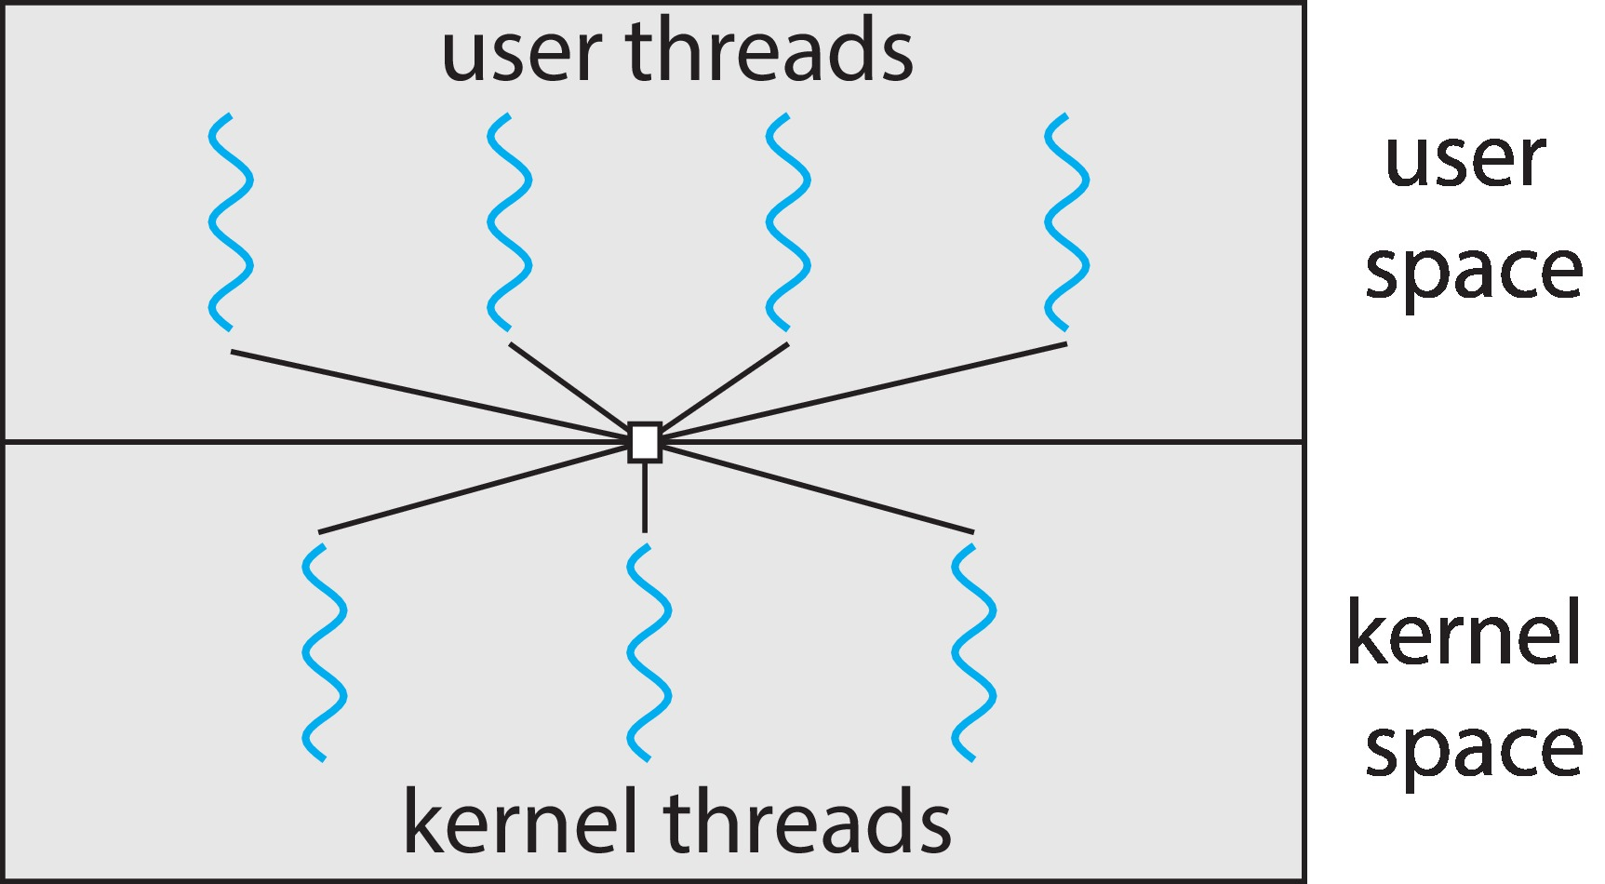
Many-to-Many Model
Allows many user level threads to be mapped to many kernel threads
Allows the operating system to create a sufficient number of kernel threads
Windows with the ThreadFiber package
Otherwise not very common

Slide 17
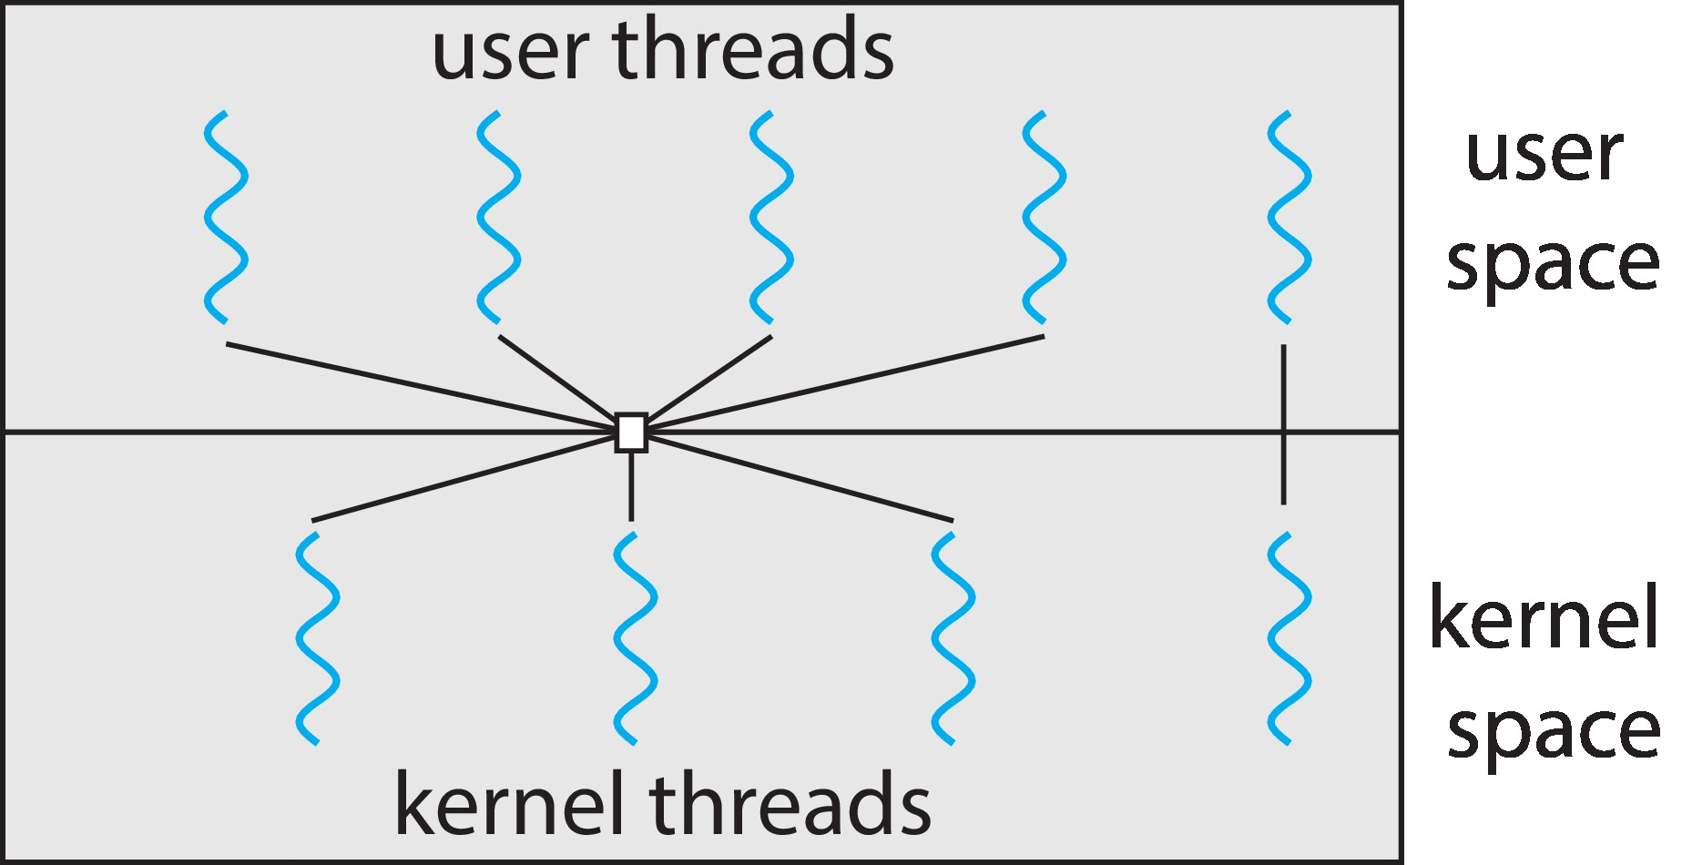
Two-level Model
Similar to M:M, except that it allows a user thread to be bound to kernel thread

Slide 18
End of Chapter 4 Part-1

